Slide 1

Clinical Trial Portals Absolutely, Positively Essential for Small, Mid-Size Biotech Firms
27-APR-2018

Slide 2
Welcome
Craig Rotzler, CMP
FDAnews

Slide 3

Our Webinar Protocol
To ensure proper audio, make sure you’ve turned up the volume on your computer’s speakers.
If you experience technical difficulties, please use the “Questions” feature and someone from our team will assist you!
If we run out of time to address your question during Q&A, we will follow-up with you via email following the webinar.
If you’d like to see this webcast again, it will be archived and made available for you to watch on demand.

Slide 4


About WCG
The WIRB-Copernicus Group…
WCG’s solutions are built upon the foundation of ethical review, but have grown to include a suite of complementary clinical services and technologies.
WCG delivers knowledge based services that accelerate growth and maximize efficiency for those who perform clinical trials.

Slide 5


Meet Your Presenters
Steven Beales Senior Vice President of IT, ePharmaSolutions
25 years of experience in IT
16 years in the Pharmaceutical industry
Led implementation of the Clinical Trial Portal at Genentech across 100+ countries
Brian Mundy Director, Product Strategy, ePharmaSolutions
15 years of experience in IT roles
11+ years working in the Life Sciences industry
Providing technology solutions for the clinical space, including Clinical Trial Portals, Site Portals, eTMFs, etc.

Slide 6
Agenda
Shift in Clinical Trials Industry
What are Clinical Trial Portals
Why are Clinical Trial Portals Essential for Small- to Mid-size Pharma
Case Study

Slide 7
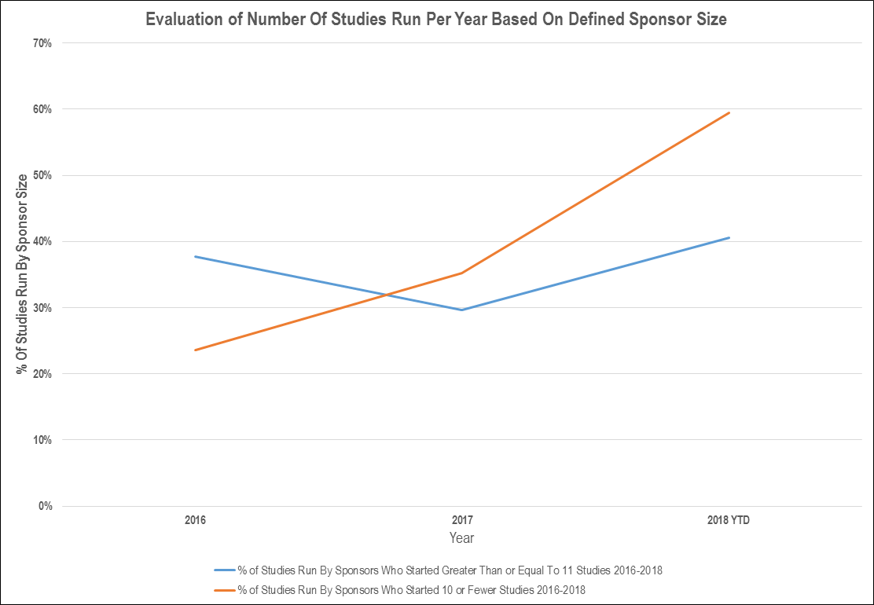
Less Studies Conducted at Big Pharma
Insert graphic on % of studies being conducted in small pharma now vs then

Slide 8
Big Pharma is Outsourcing R&D
Big Pharma
R&D $$$
Development Staff
Shed inefficient expenditures
Start-Ups
Ops
CROs/FSPs
Return on shareholder capital
Profitable use of assets
Source: “From the Trenches: Technical Strategies for Start-Up and Virtual Pharma/BioTech Companies”

Slide 9
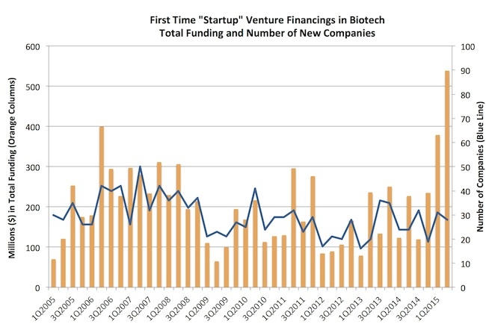
Competition is Fierce
Source: https://www.forbes.com/sites/brucebooth/2015/07/23/the-venture-funding-boom-in-biotech-a-few-things-its-not/#4e66229d3012

Slide 10
What are Clinical Trial Portals

Slide 11
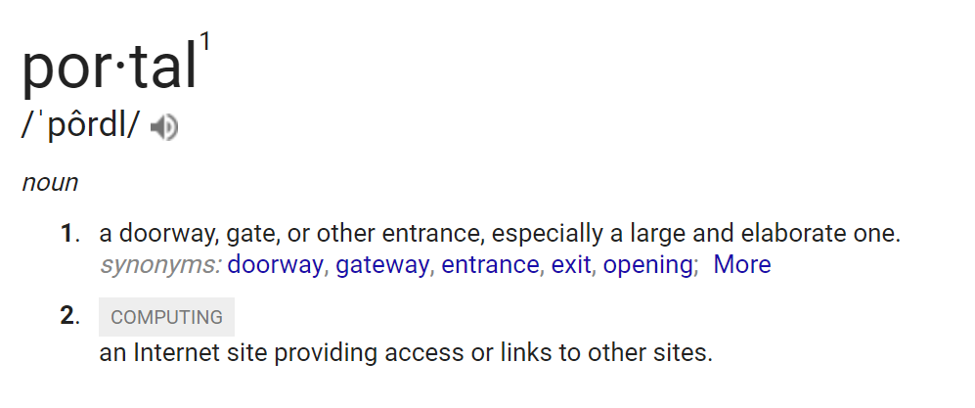
A Definition

Slide 12
An Update Definition
Clinical Trial Portal
/ˈklinək(ə)l trī(ə)l pôrdl/
an Internet application that provides:
streamlined communication across all stakeholders
systematized and standardized business process and reports across all CROs and Countries
a one stop shop for all study needs for Sites
access or links to other sites with Single Sign On

Slide 13
What Can They Do?
Site feasibility and selection
Study related documents
Signatures and approvals
Distribution of safety reports
Grant negotiation and payment tracking
Study training
Access to EDC and other online applications
Reporting
Patient recruitment and retention

Slide 14
Why are Clinical Trial Portals Essential
Notes:
Thank you Brian. A lot of bullet points for us to absorb on a Friday. Can everyone who can’t hear me raise your hands? Why are Clinical Trial Portals Essential … My father has Parkinson’s disease. He’s a veteran and a farmer so he’s always been fighting fit and strong . He takes L-Dopa and, except for a resting tremor, he is mostly OK and can perform his activities of daily living. What we fear as a family is that he will develop dyskinesia and we’ll see my father wriggling and writhing like a snake. Many of us have seen severe dyskinesia patients and it’s horrible to see. There is no drug in the UK approved to treat dyskinesia except Amantidine off label but that is only partially effective. There is a small Biotech developing a compound called NLX-112 with funding from non-profits in UK and US. This drug eliminates dyskinesia in rat models. It’s ready for Phase 2 trials. It gives me hope for my father. I’m excited to see so many people from small biotechs signed up for this webinar. We had over 280 registrants. You are most the exciting industry segment in the world today and you give us all hope. Clinical Trial Portals can help you.
I’d like to take us back to the first time I heard about Clinical Trial Portals, which was in 2008. 10 years ago it was a different world. Bear Sterns had just collapsed. Microsoft was trying to buy Yahoo. I had started a small IT Service Provider in 2002 with 2 Johns Hopkins professors and we had been modestly successful – building the CTMS systems for Johns Hopkins, Washington U and U Pittsburgh. We had grown to 60 people. Then the American recession hit. Equity funding stopped. Spending in the Academic Medical Centers froze. We failed and I had to start my career over again.
I was fortunate to get 2 opportunities – the first to build a Clinical Trial Portal for Genentech and also to help a 5 person virtual company called Diasome Pharmaceuticals. We will hear more about Diasome later. The Genentech story is not the focus of today’s story. That is a story of big pharma success, spending $10m, having a portal used by 22k sites, potentially saving $80m a year. Genentech took billions of dollars and 1000s of people to be successful. That is only interesting to us in so far as 10 years later, virtual biotechs have the chance to the same thing at 1% of the cost and scale., because of how far we have progressed the technology..

Slide 15
Improve Site Relationships
Better able to scale your relationship with Sites
Increase site satisfaction
Reduce the staff need to remember multiple credentials for the various eClinical systems
Reduce the manual and duplicate data entry
Notes:
Portals are all about managing your external partners and particularly your sites. Virtual Biotechs are all about your external partners and sites. 94% of sites in WCG’s surveys of our site network have told us that a portal makes them more likely to work with a sponsor. As a small Biotech, you’re competing for those same sites. As you know almost 50% of sites will recruit 0 or 1 patient for your study. 87% of sites told us their biggest problem was too many systems, too many usernames and passwords and too many places to go. You’re providing your sites with 1 place to go to work with you – that’s crucial when you need to outsource so much to specialist providers.

Slide 16
Do More with Less
Decrease study operating costs:
Reduce task duration by implementing collaboration or business-enablement applications.
Automate document exchange with sites and reduce courier costs.
Improve study timelines:
Offer collaboration or business-enablement applications.
Provide transparency:
Allow team members time to do high-valued thinking rather than chasing up sites or team members for information, data or documents?
Notes:
We keep metrics about the impact of portal technology independent of functional service provider excellence
24% Improvement in feasibility
16% document collection
3 days for training
Transparency and minimizing time spent on oversight is key. We’re scientists – well some of you are real scientists and I’m a computer scientist – we want to create something new that will help the world, not spend all our time chasing down information?

Slide 17
Predictability
Increase visibility and oversight capabilities:
Employ a portal that tracks activities, assigns tasks and reports activity within (and ultimately outside of) the portal.
Getting to Yes/No Quicker
Portals enable a rapid feedback loop on the progress of your study to better enable you to avoid wasting resources.
Notes:
Portals are no guarantee of efficacy. If your drug doesn’t work or doesn’t have a good enough benefit/risk ratio, portals won’t tell you that. What they will enable you to do is fail faster – get to No and move on. Only 10% of compounds make it all the way through to market. Batting .100 doesn’t get you to the majors – except if you’re playing for my beloved – and currently awful – Baltimore Orioles.

Slide 18
Differentiation
Don’t build what you don’t need yet
Partner with right sized companies bringing industry best practices
Show your focus is on your site relationships and making sites lives’ simpler
Notes:
Portals just extend how virtual Biotechs differentiate yourselves anyway. They share the same ethos. Don’t build or buy anything till you absolutely need it. Vet and verify your partner companies.

Slide 19
What does this mean for Sites?
One place to go online for all study needs; training, study documents, updates, online meetings, alerts, etc.
One URL to remember for all studies
One UserID and password for all studies
Available 24/7/365
Simple, easy to use interface
Sites have ranked “study portals” as the number one feature they would like to have from a Sponsor*

Slide 20
Case Study
Diasome Pharmaceuticals
“I have implemented Clinical Trial Portals into every study we conduct. It provides us with best-in-class decision support solution and collaboration platform to accelerate clinical development timelines while reducing cost” President, Diasome Pharmaceuticals
Conducted Phase 2b global studies as a Virtual Biotech with < 10 staff and without CRO support
$7m total cost Phase 2 trial
Industry Average $12.1m Phase 2 Endocrine
Reduced per site cost by 75%
Notes:
End with a quote from former President of Diasome. Drug failed into Phase 2b. Liposomal Oral Delivery of Insulin. Only achieved endpoint in subset of population.
$187 feasibility per site
$1535 document startup per site
$7500 per site in training vs in person training
$7600 per site for SUSARs over lifetime of study

Slide 21

Questions?

Slide 22
Thank You!
For more information about the WIRB-Copernicus Group, or Clinical Trial Portals, please email us at:
info@wcgclinical.com

Slide 23
CTP Features - that have an impact on streamlining/accelerating the process
1= Highest 5 = Lowest
Feature Sponsor Benefit Site Benefit
Site Feasibility 1 1
Secure Document Exchange 2 3
Study Training 1 2
Safety Notifications 1 2
Patient Recruitment & Enrollment 1 2.5
Grant Payment Tracking 2 1
Single Sign-On 2 1
Progress Reporting 1 3
User Administration 1 2
Communication/Calendar 1 1

